Slide 1


Government Healthcare System
Team Members:
1154_Prashant Kontam
1161_Mangaldeep Dewangan

Slide 2

Contents
Abstract
Introduction
Requirements
Features
Technologies
Conclusion
References

Slide 3
Abstract
Government Health care system is a web based application is intended to improve entire Governments hospitals working process in a states. This System provides a facility to patients , to online schedule a appointment with a doctor for check-up. For doctors This System Provide a facility, they can have a access to see the history reports of patients. This system also provides facility to admin who is health officer, admin role is to monitor all doctors work and have access to see all the doctors success rate as well as patients feedback towards doctor.

Slide 4

Requirements
Registered patients only can access application.
Patients should schedule appointment online.
Doctors have access to see his appointment list.
Doctors Have access to patients history report.
Health officers should have access to see all the patients feedback.

Slide 5
Aims & Objectives
To produce a web-based system that allow the admin to monitor on all the government doctors and hospitals.
To easy patients to Schedule their appointments online.
To ease for doctors to check patients history report.

Slide 6
Features
Patients can schedule online appointment.
Doctors can see patients history reports.
Health officer can see patients feedback towards hospitals and doctors.
Patients can not schedule on already booked appointments.
Password stored in encryption format.

Slide 7
Actors
Patient
Doctor
Health-Officer ( Admin )

Slide 8
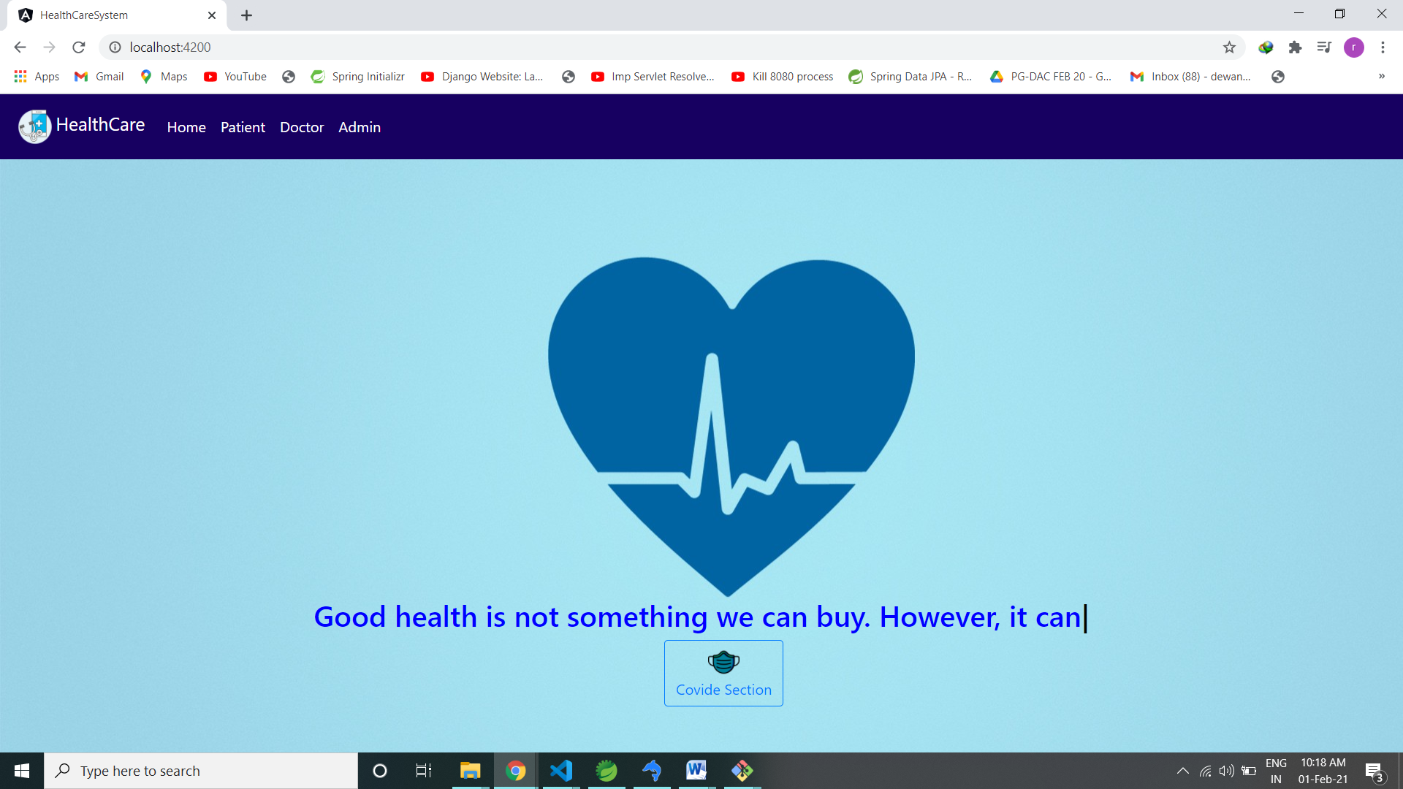
System UI

Slide 9
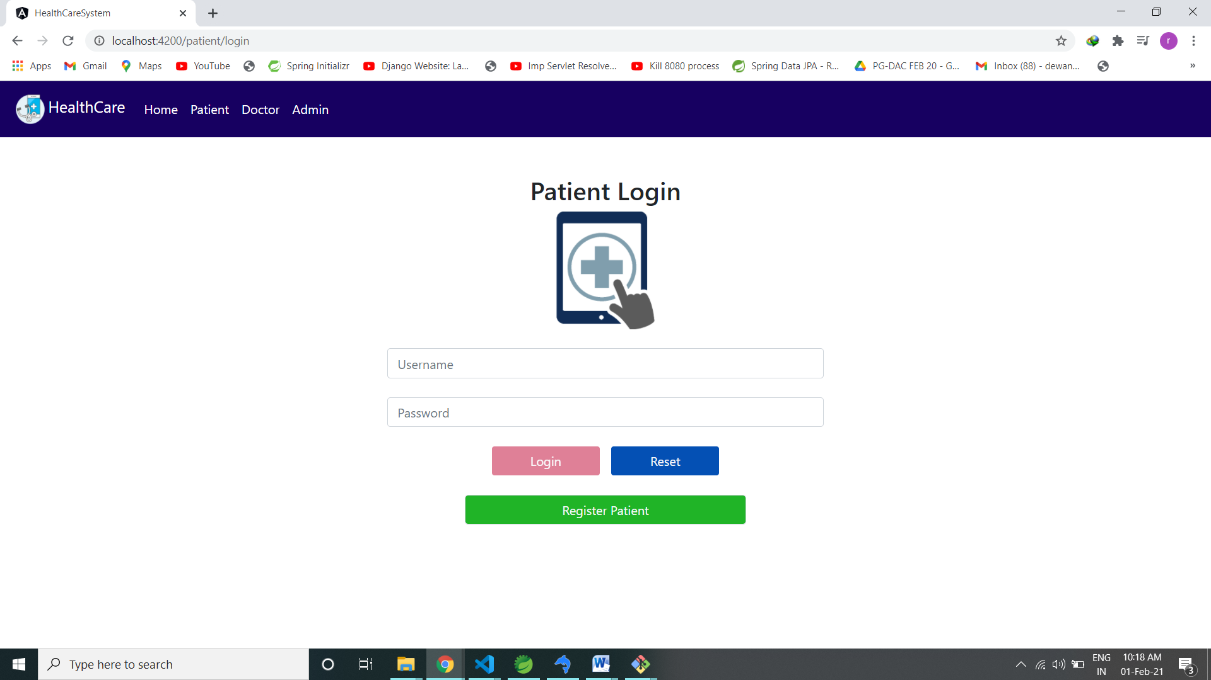
Patient Log-In

Slide 10
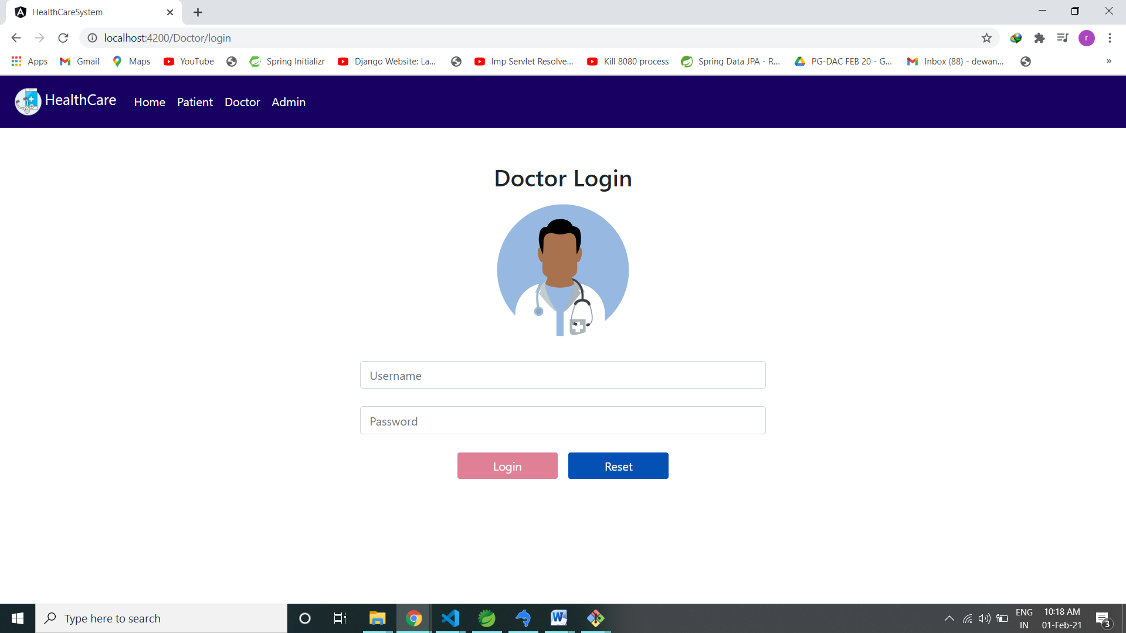
Doctor Log-In

Slide 11
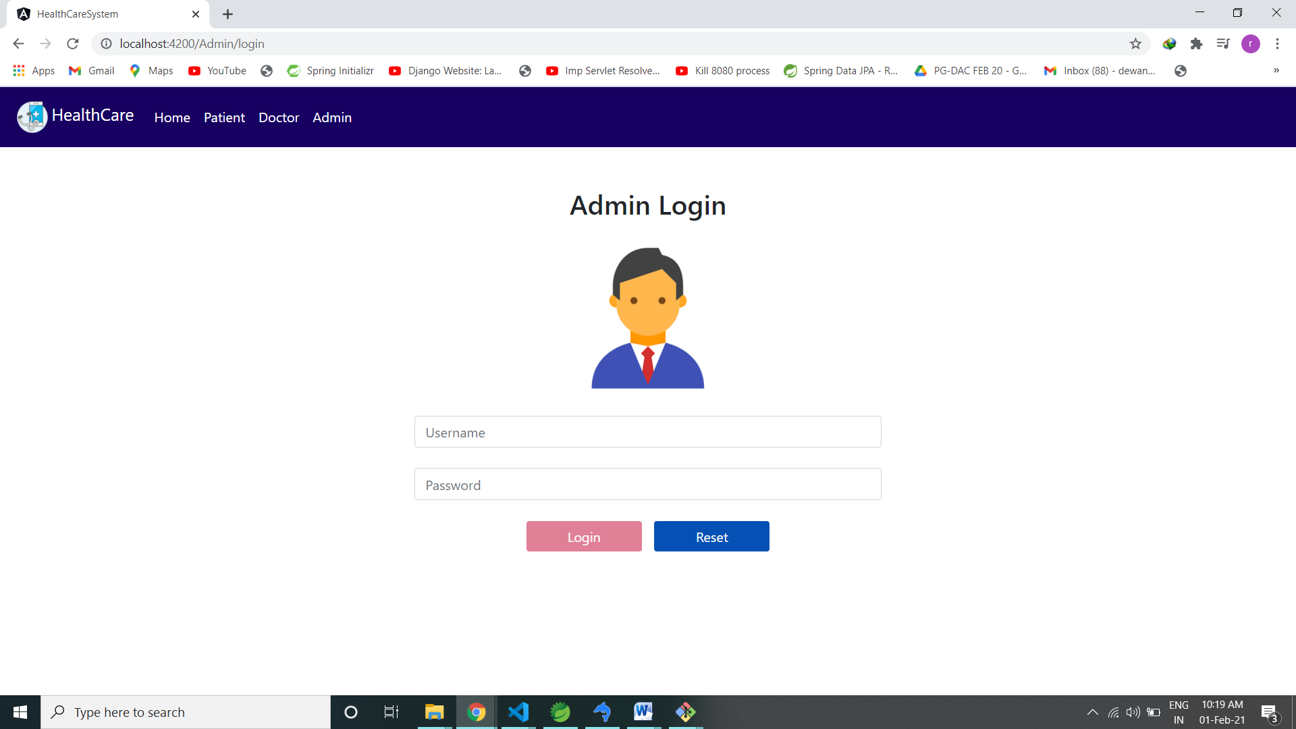
Admin Log-In

Slide 12
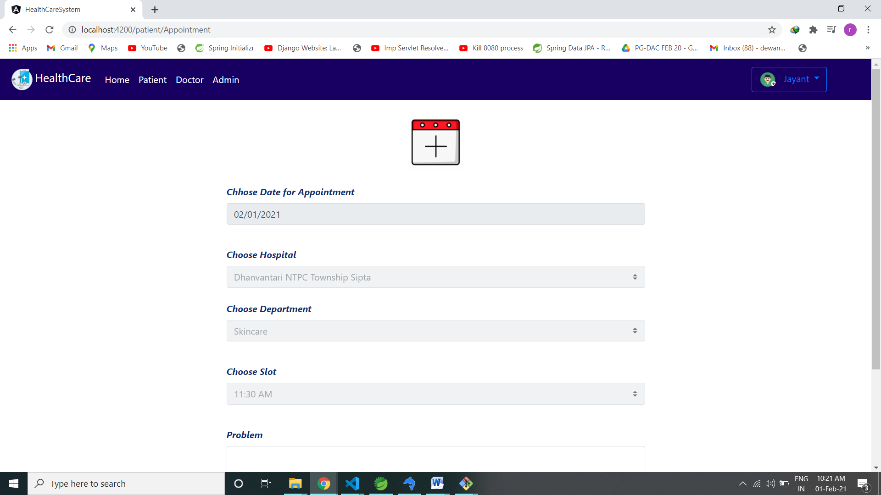
Schedule Appointment

Slide 13
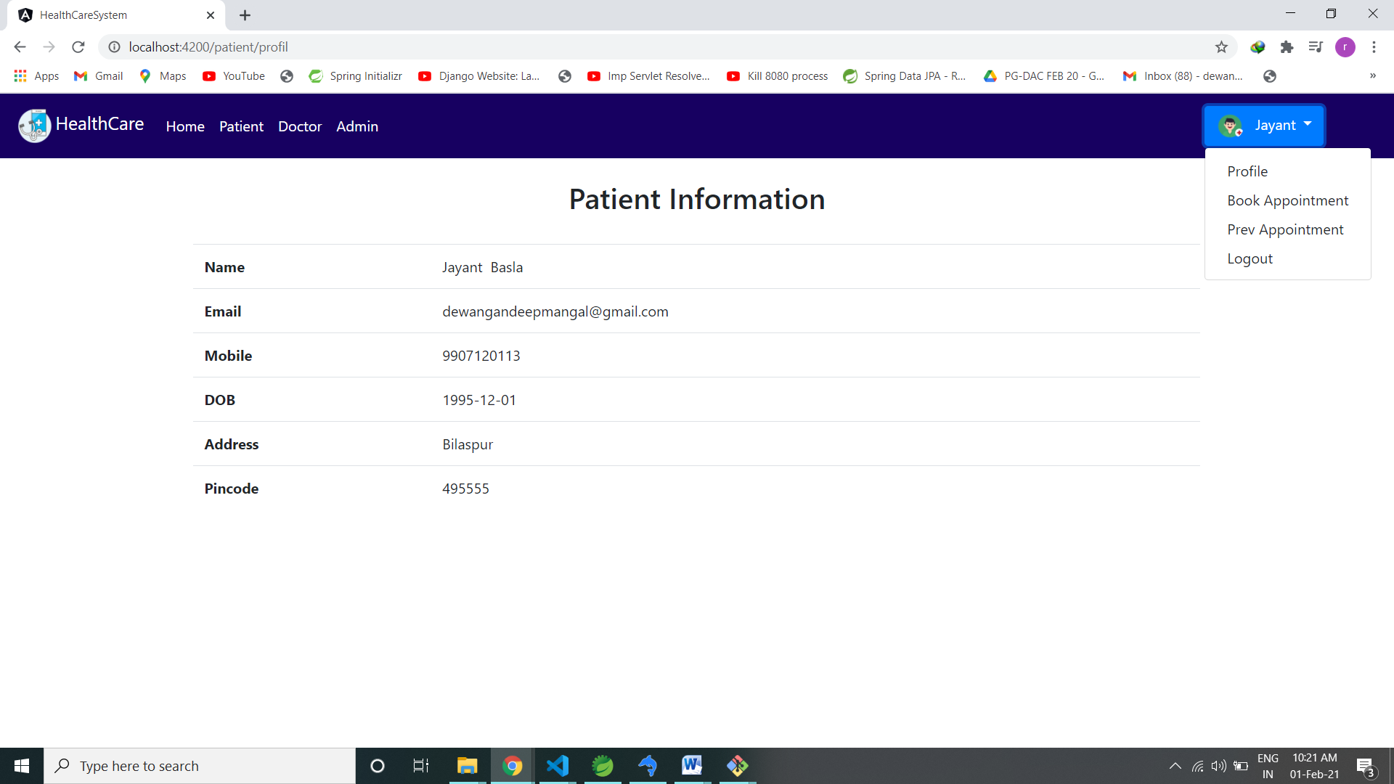
Patient Information

Slide 14
Technologies
Front-End : Angular 10, Bootstrap
Back-End : Spring Boot Rest Api
Database : MySql

Slide 15
Conclusion
Government HealthCare System improves the current government hospital monitoring process and by observing the patients feedback they can improve the government medical service and patient also can schedule their appointments online.

Slide 16
References
https://spring.io/projects/spring-boot
https://angular.io
https://dev.mysql.com/doc/
https://www.techiediaries.com/angular-bootstrap/
https://springframework.guru/spring-framework-annotations/

Slide 17

Thank You

